Slide 1
LoRa-Based Stable Difussion For Synthetic ADC and SCC Image Generation In Medical Education
Final Project Proposal
Muhammad Hanif Pearlyaradja
103012340237
IF-47-INT

Slide 2
Background
Background
Lung cancer is one the most disease that caused death in the world according to GLOBOCAN 2022
The doctors must be able to differentiate between 2 types of lung cancer subtypes, namely ADC and SCC through the samples.
Distinguishing those two cell under a microscope is very difficult due to the similar shape .
AI technology may can help recognize cells, but AI needs thousands of sample.
Research focus
Lung Cytology (ADC & SCC) → Synthetic Image Generation → Stable Diffusion v1.5 → Low-Rank Adaptation (LoRa) → Evaluation (FID & KID)

Slide 3
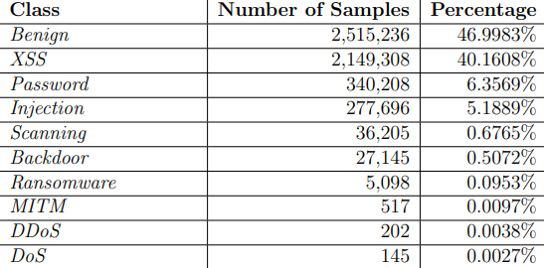
Dataset Challenge
Research Problem
The clinical lung cancer cytology dataset provides labelled cell images, but it has several challenges:
Extremely small sample size (only 417 images)
Severe class imbalance (approx. 10:1 ratio)
Minority cell classes are difficult to synthesize
Subtle and ambiguous morphological features

Slide 4
Problem Formulation and Objectives
Problem Formulation
How can stable diffusion v1.5 be fine-tuned via LoRa under an image-to-image framework to produce realistic lung cytological features from a highly limited dataset ?
To what do degree do generated images meet quantitatives standards (FID & KID) to act as valid educational visual assets?
Objectives
Develop and implement a structurally conditioned latent diffusion model with low-rank adapters to address clinical specimen scarcity
Evaluate distribution similarity against the ground truth using unbiased quantitative measurement to validate medical training utility

Slide 5
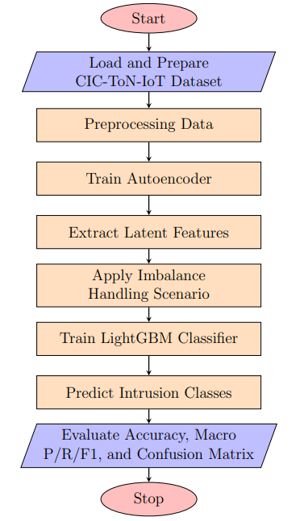
Proposed Workflow
Proposed Workflow
Preprocessing : Standarize images to 512x512 pixels,normalize values to [-1,1], and prepare basic augmentations
Condition Maps : Extract spatial structural edges and nuclear boundaries to act as exlicit shape guidances cues.
LoRa Fine-Tuning : Excecute class-wise parameter-efficient training separately on U-net attention layers
Generation & Metrics : Synthesize 20 - 100 images per class and compute FID and KID relative to original

Slide 6
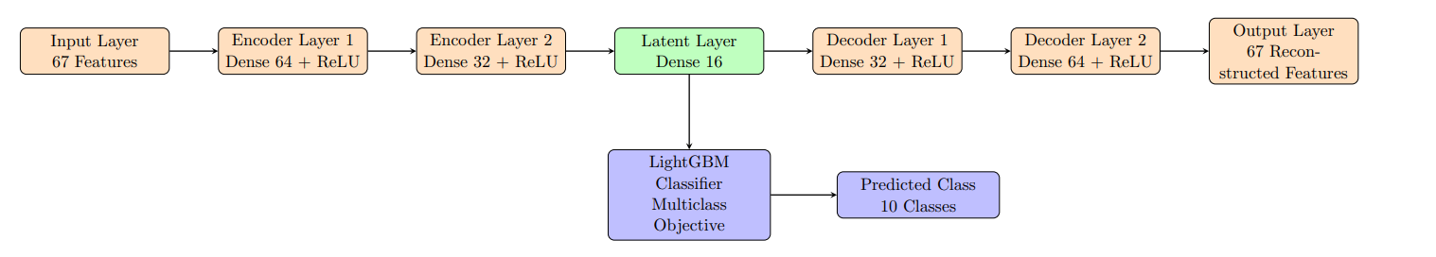
Model Architecture
Research Problem
Our methodology leverages Image-to-image translation guided by structural cell masks:
Latent Space Denoising : Operates inside compressed spaces via pre-trained VAE to optimize memory.
Domain Anchor Prompting : Fixes laboratory stainig styles via static background guidance commands.
Structural Preservation : Preserves complex sub-cellular structures via conditioning networks.

Slide 7
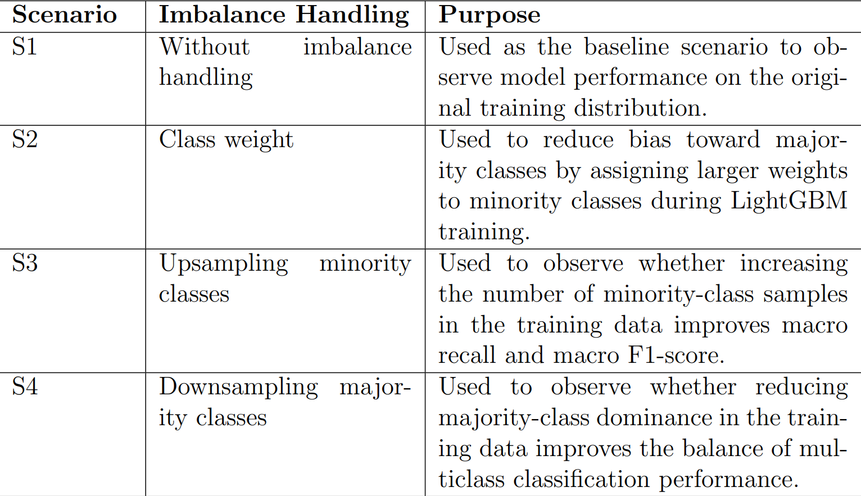
LoRa Fine-Tuning
We lock base model weights and only train two low-rank matrices to captures cytological structural patterns:
Hardware Efficiency: Reduces trainable parameters from 860 million to only ~3-5 million. This severly lowers overfitting risks when training on our highly limited SCC dataset.

Slide 8
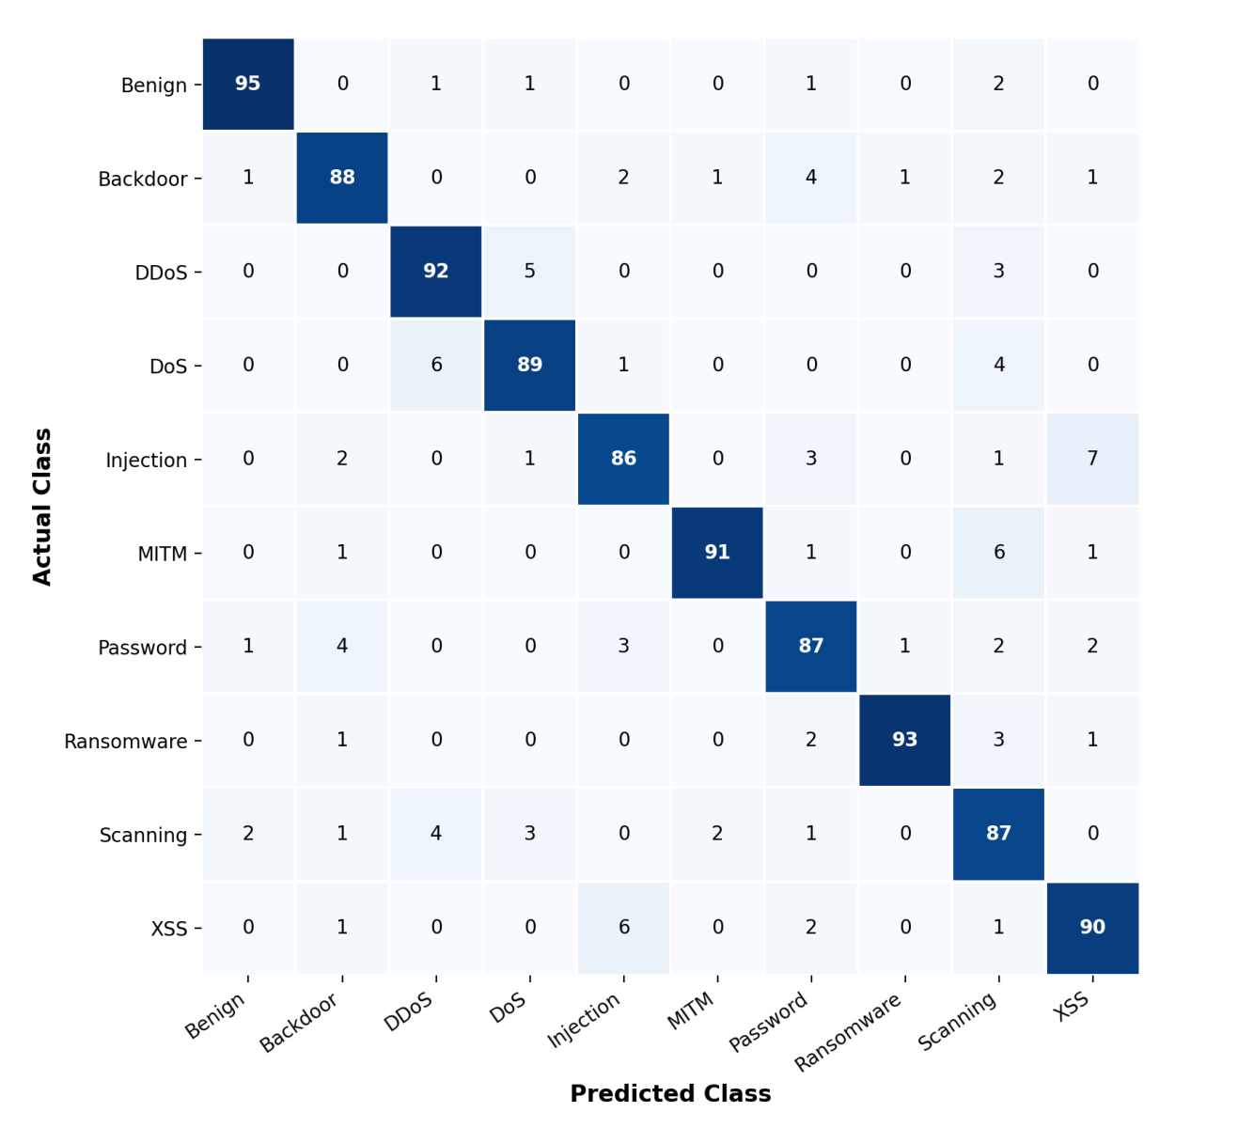
Evaluation Metrics
To objectively ensure synthetic cells model biological ground truts accurately, generated feature distribution are measured via standard computer vision metric:
Frechet Inception Distance (FID): Compute the wassertein-2 distance between feature distribution of original synthetic images, scores from 10-40 are validated as highly acceptable for medical imaging tasks.
Kernel Inception Distance: Utilize polynomical Maximum Mean Discepancy (MMD). Crucially, KID functions as an unbiased estimator, making it exceptionally reliable on small minority sets (such as our 39-sample SCC class) where FID calculations become mathematically unstable.

Slide 9
Expected Contribution
Expected Contributions
Imbalance Resolution : Balances clinical cytological sample classes by delivering 20-100 high-fidelity synthetic SCC images.
Educational Assets : Empowers medical student with high-resolution visual specimens or rare cancer phenotypes.
HIPAA & Privacy Ease : Provides fully synthetic training data with zero patient identification or data sharing constainst.
Stable Diffusion & LoRa → Latent Space denoising → Sythetic Cytology → 2 Classes

Slide 10
Conclusion
This proposal focuses on:
Cell morphological complexity
Extreme clinical class imbalance
Parameter-efficient training
Synthetic cytological generation
Proposed pipeline
Lung Cytology Dataset → Preprocessing → Stable Diffusion v1.5 → Low-Rank Adaptation (LoRa) → Synthetic Generation → Evaluation (FID & KID)
THANK YOU

